Slide 1

PART 1 · THE OPPORTUNITY — MARKET CONTEXT
Myntra's Scale Makes a Small Wishlist-Conversion Gap Worth Hundreds of Crores
THE OPPORTUNITY, SIZED
TAM $21B
India's fashion e-commerce market. Outlook Business/Whalesbook, 2026 — Myntra ~30–35% share.
SAM 24.5M
Myntra wishlist-active users per month. Modeled — 35% of 70M MAU, market research case study.
SOM ~15M
Active Comparers, 61% of wishlist-active users. Wishlist Behavior Survey, n=36.
India's online fashion sector grows at a 21.1% CAGR through 2030 — Myntra is its largest dedicated platform. (Whalesbook)
At this scale, a few percentage points of wishlist conversion is not a rounding error — it's real money already sitting on the platform:
Even the conservative scenario — a 5-point conversion lift — is modeled at ₹265 Cr in incremental annual revenue, ~12% of Myntra's entire FY25 net profit, with no new acquisition spend, because it monetizes demand already on the platform.
Source: Myntra Market Research & Case Study (Sept 2026).
Myntra Growth · Wishlist-to-Purchase Conversion
1

Slide 2






PART 1 · THE OPPORTUNITY — METRIC DECOMPOSITION
The 30-Day Conversion Metric Hides Five Separate Failure Points
A single number can't say where the item is lost:
“% of users who purchase at least one wishlisted item within 30 days of adding it”
A. Re-engagement
FOCUS
B. Uncertainty Resolution
Constraint: no monetary incentives — discounts, coupons, and cashback are excluded as the primary lever.
C. Comparison Resolution
FOCUS
D. Decision Trigger
E. Purchase Completion
MVP FOCUS: Stage A → C. Fixing re-engagement and comparison resolution raises the ceiling on every downstream stage — not a returns or price fix.
Live MVP (“TieBreaker”) → open ↗
Live Review Analysis Agent → open ↗
Full decomposition: reports/metric_decomposition.md
Myntra Growth · Wishlist-to-Purchase Conversion
2

Slide 3







PART 2 · DISCOVERY & RESEARCH — AI ENGINE
The Loudest Complaint in Reviews Isn't the Real Wishlist Blocker
How the AI discovery engine reached this ranking:
Ingest
Relevance Filter
AI Extraction
Synthesize
Score
Console
24,575
17,343
12,277
20
Canonical records
Relevant records
Records extracted
Ranked opportunities
↓ −1,307 not real feedback (catalog copy / too short / ops-only) · −767 non-English, dialect, or emoji-only · −5,066 no quotable evidence span
Two rankings disagree on where to fix the funnel:
#1 BY RAW VOLUME
#1 BY WISHLIST-RELEVANCE
opp:returns_exchange
opp:comparison_loop
12.0% of relevant records (2,084) — hesitation-link 0.11, the LOWEST of the top 10.
Only 3.0% of relevant records (522) — hesitation-link 0.63, the HIGHEST of all 20 scored.
App-store reviewers are disproportionately people who already bought and are complaining post-purchase.
Low volume, but structurally the theme most tightly coupled to the actual wishlist-to-buy decision.
Full register: reports/opportunity_register.md
Myntra Growth · Wishlist-to-Purchase Conversion
3

Slide 4



PART 2 · DISCOVERY & RESEARCH — PRIMARY RESEARCH
Survey and Interviews Agree: Shoppers Compare, Then They Forget
Why an item gets removed without ever being bought (n=36):
CONVERTER · SMALL, CURATED WISHLIST
Anjali
“I wanted to compare, shortlist and compare.” Wants a physical Try & Buy bundle to resolve fit doubt on unfamiliar brands.
NON-CONVERTER · 1,220-ITEM WISHLIST
Bhargavi
“I get bombarded with alerts... I end up ignoring them.” Wants AI-curated wishlist surfacing, not a comparison tool.
Source: Wishlist Behavior Survey — view full responses. Top slice = the “42%” cited throughout this deck.
Full findings: reports/interview_findings.md
Illustrative personas (segment archetypes built from the survey + both interviews -- not additional respondents):
The Active Comparer
The Serial Bookmarker
Converts when the comparison resolves in-app
One wishlist, many intents -- mostly passive
• Small, curated wishlist
• Wishlists specifically to compare
• 61% of survey respondents show this motive
• Wishlist in the hundreds to thousands
• Active Comparer for one item at a time
• Notification-fatigued at scale (interview)
Myntra Growth · Wishlist-to-Purchase Conversion
4

Slide 5



PART 2 · DISCOVERY & RESEARCH — PROBLEM DEFINITION
Active Comparers Don't Say No — They Just Never Decide
“Active Comparers” — users who wishlist an item while still comparing it against alternatives. The largest, most consistent segment across the AI pipeline, the survey, and both interviews (61% comparison motive) — confirmed as a per-item state, not a fixed user trait.
Root cause
Result
Why it matters
The wishlist is a passive bookmark, not a decision workspace.
Resolves off-platform (42%) or never at all (32% forget).
Not price or returns — decision support, no incentive needed.
RICE prioritization — same Frequency / Hesitation-link / Evidence-confidence columns already published in reports/opportunity_register.md, plus a labeled engineering-effort estimate. This reinforces, not revises, the funnel ranking:
Opportunity | Reach | Impact | Confid. | Effort | RICE
Comparison Resolution | 3.0% | 0.63 | 0.78 | Low | 1.49
Re-engagement (forgetting) | 5.1% | 0.50 | 0.63 | Med | 0.82
Fit Confidence | 12.3% | 0.24 | 0.44 | Med | 0.65
Visual/Review Proof | 11.6% | 0.27 | 0.61 | High | 0.63
Returns/Exchange Friction | 12.0% | 0.11 | 0.81 | High | 0.35
Reach = % of relevant records · Impact = hesitation-link · Confidence = evidence_confidence · Effort is a planning estimate (not published elsewhere) · RICE = (Reach×Impact×Confidence)/Effort-weight
Myntra Growth · Wishlist-to-Purchase Conversion
5

Slide 6



PART 3 · THE SOLUTION — RATIONALE
Four Validated Hypotheses, One Mechanism That Resolves Them
1
Comparison Resolution
Why “TieBreaker” fits: the AI agent resolves the exact comparison respondents described unprompted, in-app instead of on a competitor's site.
opp:comparison_loop · hesitation-link 0.63
2
Re-engagement (forgetting)
Why “TieBreaker” fits: the fast-forward nudge pulls a stale comparison back before attention decays — the #1 blocker among non-converters.
opp:intent:uncertain · hesitation-link 0.50
3
Visual / Review Proof
Why “TieBreaker” fits: the comparison card surfaces the same structured product detail respondents said they lacked, without leaving the app.
opp:image_vs_reality · hesitation-link 0.27
4
Fit Confidence
Why “TieBreaker” fits: the agent reasons directly over each item's size/fit notes — precisely the unfamiliar-brand uncertainty both interviews described.
opp:fit_uncertainty · hesitation-link 0.24
ALTERNATIVES CONSIDERED AND REJECTED (reports/solution_concepts.md)
Recoverability preview
Worth-it proof at current price
Delivery date on SKU
Hesitation-link 0.11 — post-purchase noise.
Reads as monetary framing — against our constraint.
Evidence base only 0.82% — logistics only.
The moat: every reason-tagged comparison feeds back into the dataset — at Myntra's scale (200M+ annual active users), that compounds faster than a smaller rival can replicate the same structured signal.
Myntra Growth · Wishlist-to-Purchase Conversion
6

Slide 7




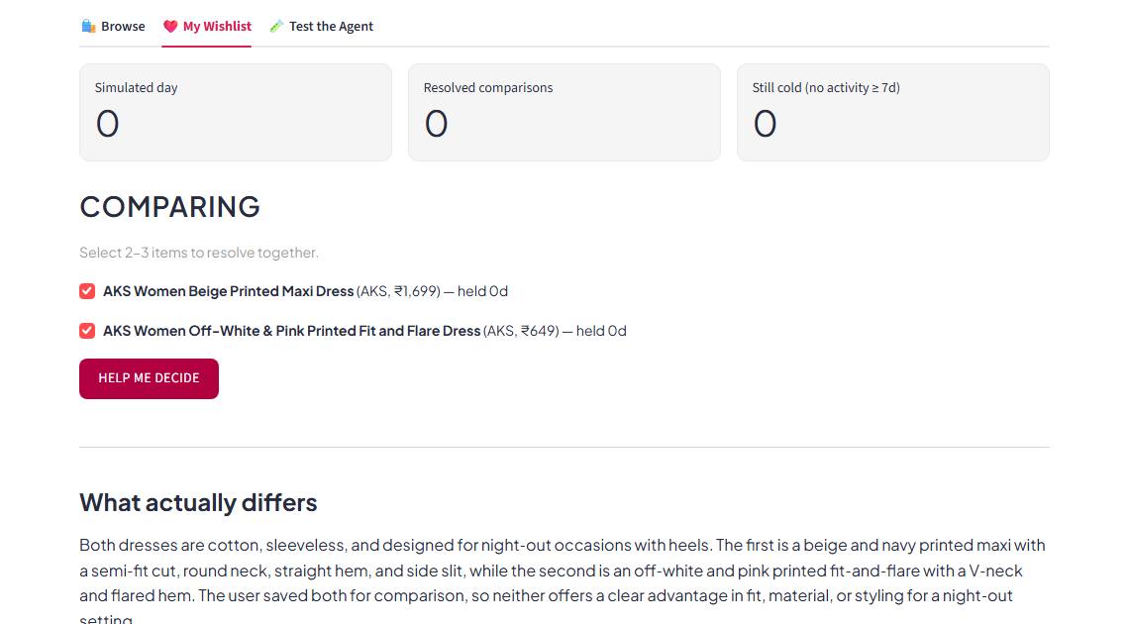
PART 3 · THE SOLUTION — MVP
TieBreaker: An AI Agent That Resolves the Comparison In-App
A standalone Streamlit app on the real Myntra catalog (451 in-stock items, 4 categories) and the same LLM client as the discovery pipeline — no mock data.
How a comparison gets resolved, end to end:
2+ Tagged Items
Build Prompt
Groq LLM Call
Validate Response
User Decides
Reason capture
One-tap chip at save-time: comparing, occasion, fit, or just liked it.
AI comparison agent
Recommends between saved items using real attributes — no price framing.
Live MVP (“TieBreaker”) → open ↗
Myntra Growth · Wishlist-to-Purchase Conversion
7

Slide 8




PART 3 · THE SOLUTION — HOW IT WORKS
From Browse to Decision in Four Steps
1
2
3
4
Browse & Save
Tag the Reason
Get Nudged
Agent Resolves It
User adds a real product to their wishlist from the catalog.
One tap: comparing, occasion, fit, or just liked it.
Stale comparisons surface a “still deciding?” prompt.
AI compares real attributes; user buys, keeps, or removes.
Every step is a real Streamlit widget wired to session state and the live LLM agent — nothing here is a mockup.
Myntra Growth · Wishlist-to-Purchase Conversion
8

Slide 9



PART 4 · PROOF & PATH TO SCALE — METRICS & RISKS
Comparison Resolution Rate Rises Only if Every Guardrail Holds
Primary: resolved ÷ (resolved + still-cold)
CRITICAL RISKS THESE GUARDRAILS WATCH (4 of 11)
Correlation, not causation
LEADING INDICATORS
Mitigation: primary metric framed as a hypothesis-linked proxy, gated by a real A/B test.
Reason-capture rate
Nudge-to-engagement rate
“Help me decide” invocation rate
Reason-tag friction shrinks the funnel
Recommendation-acceptance rate
Guardrail: wishlist add rate must hold steady or grow.
GUARDRAILS (metrics that pause rollout on breach)
Wishlist add rate (must hold)
Agent steers a bad decision
Add-flow abandonment rate
Guardrail: regretted-removal rate.
Regretted-removal rate
Agent failure rate
Monetary-language leakage
Monetary-language leakage (0%)
Guardrail: automated scan, target 0%.
Full metrics: reports/define_success.md
Full risk register (11 total): reports/risks_and_mitigation.md
Myntra Growth · Wishlist-to-Purchase Conversion
9

Slide 10

PART 4 · PROOF & PATH TO SCALE — CLOSING
Closing This Gap Is Worth ₹265–688 Crore a Year
SCENARIO | CONVERSION LIFT | INCR. ANNUAL GMV | INCR. REVENUE | INCR. PROFIT
Conservative | 12% → 17% (+5pp) | ₹2,205 Cr | ₹265 Cr | ₹66 Cr
Moderate | 12% → 20% (+8pp) | ₹3,528 Cr | ₹423 Cr | ₹106 Cr
Aggressive | 12% → 25% (+13pp) | ₹5,733 Cr | ₹688 Cr | ₹172 Cr
Even the conservative scenario (+5pp) is ~4.4% of Myntra's entire FY25 revenue and ~12% of its FY25 net profit — at a higher margin than average, since it monetizes demand already on the platform. Modeled estimate on labeled assumptions, not a Myntra-disclosed figure.
5 of the 11 identified risks already have a guardrail or leading-indicator metric watching for them — designed against these exact failure modes, not in a vacuum.
PATH TO SCALE
1 · Pilot
2 · Validate
3 · Scale
Ready-to-test experiments as scoped prototypes. Gate: directional lift, 0% leakage.
Powered 30-day A/B on real conversion. Gate: significant lift, guardrails hold.
Public deployment + mechanism-preference signal. Gate: north star trending up, base-wide.
Myntra Growth · Wishlist-to-Purchase Conversion
10

